Slide 1
THE UNCIRCUMCISED HEART
WAILING WOMEN TRAINING
AUGUST 2 2022
TRAINING MANUAL VOL 3 CHAPTERS 4-5

Slide 2
THE UNCIRCUMCISED HEART
OPPOSES GOD
SPEAKS EVIL OF OTHER PEOPLE
ENJOYS THE COMPANY OF SINNERS
RATIONALES OFFENCE
CANNOT SINCERELY REPENT

Slide 3
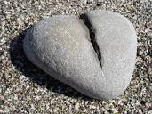
EXAMPLES FROM THE WORD
A STONY HEART
A TROUBLED HEART
A HARDENED HEART
STONY HEART | Troubled Heart | Hardened Heart
EZEKIEL 11:19 | John 14:1 | Hebrews 3:15
Hardened to sin | Full of Fear | Rebels
Cannot repent | Worries
Attracts judgement

Slide 4
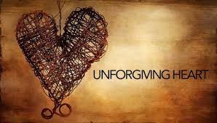
EXAMPLES FROM THE WORD
A PROUD HEART
A WAVERING HEART
AN UNFORGIVING HEART
Proud Heart | Wavering Heart | Unforgiving Heart
I Peter 5 5-6 | JAMES 1 5-7 | Luke 6:37
Has disdain for God | Full of Doubt | Holds Grudges
 | Does not receive definite answers to prayers | Keeps a detailed record of wrongs

Slide 5
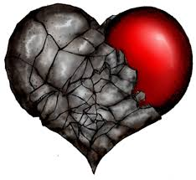
EXAMPLES FROM THE WORD
A SINFUL AND REPROBATE HEART
AN ANGRY HEART
AN INSOLENT AND DISRESPECTFUL HEART
Reprobate Heart | Angry Heart | Insolent Heart
Romans 1 28-32 | Ecclesiastes 7:9 | Exodus 5:2
Has disdain for God | Foolish | Disrespects Authority
Sold out to Satan | Bitter | Disdainful and Unbending
 | Ephesians 4:31

Slide 6
THE IMPORTANCE OF REPENTANCE AS INTERCESSORS
OUR ROLE IN THE COURTS OF HEAVEN

Slide 7
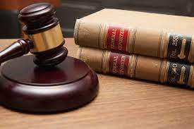
for the accuser of our brethren is cast down, which accused them before our God day and night. Rev 12:10
,

Slide 8
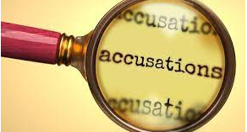
REPENTANCE
HUMILITY
SURRENDER

Slide 9
PRESENTING YOUR CASE IN THE COURTS
WHEN WE REPENT , WE SET IN PLACE THE VOICE OF THE BLOOD OF JESUS
WE AGREE WITH WHAT IS SAID ABOUT THE BLOOD- WASHES AWAY SIN, INIQUITY AND TRANGRESSION
WE REMOVE THE LEGAL RIGHT (OF SIN) FROM THE ARSENAL OF THE ENEMY.

Slide 10
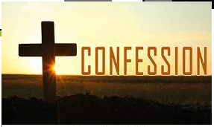
WHEN WE CONFESS OUR SINS, THIS IS THE SACRIFICE OF OUR LIPS
1 JOHN 1:19
OUR WORDS SET THE COURT IN MOTION- THE WORDS OF THE TESTIMONY.
USING THE RIGHT WORDS IN THE COURTS,
HOS 14:1-2

Slide 11
CLEANSING THE BLOOD LINE
⁴ And he answered and spake unto those that stood before him, saying, Take away the filthy garments from him. And unto him he said, Behold, I have caused thine iniquity to pass from thee, and I will clothe thee with change of raiment.- Zechariah 3:4

Slide 12
SECRETS TO CLEANSING THE BLOOD LINE
1.ALL OUR SINS AND TRANSGRESSIONS WERE DEALT WITH ON THE CROSS
Blotting out the HANDWRITING of ORDINANCES that was against us, which was CONTRARY to us, and took it out of the way, nailing it to his cross;-
Colossians 2:14
HANDWRITING- hand written law
ORDINANCES- Law
CONTRARY- covert or HIDDEN

Slide 13
SECRETS TO CLEANSING THE BLOOD LINE
The EXECUTION of the FINISHED works is imperative to winning in the courts and revoking curses- THE BLOOD
to Jesus the mediator of a new covenant, and to the sprinkled blood that speaks a better word than the blood of Abel.-Heb 12:24
But he WAS pierced for our transgressions, he WAS crushed for our iniquities; the punishment that brought us peace WAS on him, and by his wounds we ARE healed.- Is:53-5
When we repent, we come into agreement with the Blood with the Cross and the transgressions, sins and iniquity nailed to it.

Slide 14
SECRETS TO CLEANSING THE BLOOD LINE
OUR BLOOD LINES GO BACK TO ADAM AND EVE
I, the Lord your God, am a jealous God, PUNISHING the children for the SIN OF THE PARENTS to the THIRD AND FOURTH GENERATION of those who hate me, ⁶ but showing love to a thousand generations of those who love me and keep my commandments. Exodus 20:5

Slide 15
SECRETS TO CLEANSING THE BLOOD LINE
INVESTIGATE WHAT WE CAN IN THE NATURAL
And surely your blood of your lives will I require; at the hand of every beast will I require it, and at the hand of man; at the hand of every man's brother will I require the life of man.⁶ Whoso sheddeth man's blood, by man shall his blood be shed: for in the image of God made he man.- Gen 9 1-6
As you investigate the generations you will discover patterns

Slide 16
SECRETS TO CLEANSING THE BLOOD LINE
ASK GOD FOR SUPERNATURAL KNOWLEDGE
VISIONS
DREAMS
PROPHESIES
If we ask God, he will reveal hidden issues in our bloodline

Slide 17
SECRETS TO CLEANSING THE BLOOD LINE
CONNECT WITH SEERS OR PROPHETS
Ask God to provide those with true gifts

Slide 18
COLOSSIANS 2:12-15
¹³ When you were dead in your sins and in the UNCIRCUMCISION of your flesh, God made you alive with Christ. He forgave us all our sins, ¹⁴ having canceled the charge of our legal indebtedness, which stood against us and condemned us; he has taken it away, nailing it to the cross. ¹⁵ And having disarmed the powers and authorities, he made a public spectacle of them, triumphing over them by the cross.

Slide 19
BIBLIOGRAPHY
Henderson, Robert (2014) – Operating in the Courts of Heaven (Robert Henderson Ministries)
Henderson, Robert (2016)- Unlocking Destinies form the Courts of Heaven (Robert Henderson Ministries)

